Slide 1
Open RAN
Dian Hanifudin Subhi

Slide 2
Outline
Weekly report
Summary of this week’s work
Your work
Conclusion
Your opinion/thought
Action item

Slide 3
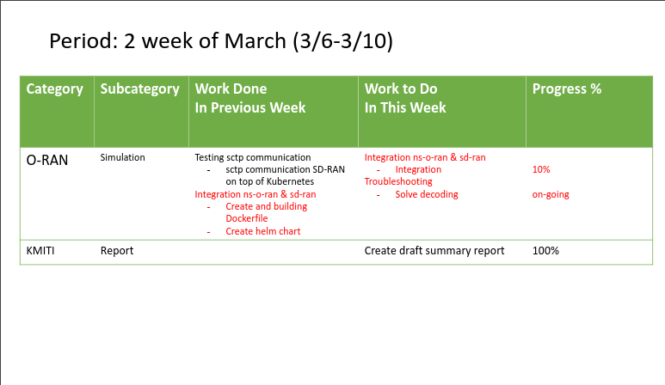
Weekly report

Slide 4
Summary of work this week
Create draft summary report of KMITI
Progress ns-3 integration with SD-RAN

Slide 5
Question to be Answered
How is the progress of ns3 integration with SD-RAN?

Slide 6
Draft report of KMITI
Create summary and future plans
Read interim report from previous report
Create summary and future plans based on the ICGHIT paper and other references

Slide 7
Testing with different version
Testing with different ubuntu version
Create KVM with ubuntu 20.04
Setup OpenRAN Gym + ns3 -> unstable simulation
Install the SD-RAN v1.4.0 -> decoding still exist

Slide 8
Testing with SD-RAN latest version
Setup SD-RAN
Install docker using snap version to support new sdran-in-a-box setup script
sudo snap install docker
SD-RAN
make riab OPT=ransim VER=latest
Result: decoding issue still exists

Slide 9
Optimize building docker image
Add script to build before packaging as image
Move script to install dependencies and building ns-3 project from Dockerfile to bash script to speed up process.
Details of implementation can be accessed in branch feature-script in https://github.com/dhanifudin/ns-sd-ran
Pros: Faster image build
Cons: Docker base image limited to ubuntu (larger image)

Slide 10
Conclusion
Create draft summary report of KMITI
Decoding issues still exist in different versions of ubuntu and SD-RAN
Moving the script to build can decrease build image time, but the base image is limited to ubuntu.

Slide 11
Your opinion/thought
Deep analysis of e2sim, oran-interface and ns3-mmwave related with encoding is needed to fix decoding.
Unstable simulation of OpenRAN Gym and ns3 maybe related with decoding issues

Slide 12
Action items
Study of ASN.1 to understand encoding and decoding
Deep analysis of encoding in e2sim, oran-interface and ns3-mmwave project

